Slide 1



Cyclistic bike-share Capstone Project
Presented by : Lucas Lau
Last update: 05/01/2024

Slide 2

TABLE OF CONTENTS
01
02
03
Objective
Methodology
Introduction & Background
04
05
Analysis & Insight
Recommendation

Slide 3

01
Introduction & Background

Slide 4




Chicago: A Premier Bike-Friendly City
Population and Significance
Third-most populous city in the U.S.
Major hub for transportation, technology, and culture.
Commitment to Cycling
Recognized consistently as a top bike-friendly city in the U.S.
Notes:
Chicago, renowned for its vibrant culture, robust technology sector, and bustling transit systems, stands as the third largest city in the United States with a bustling population of 2.7 million residents. It is positioned behind only New York City and Los Angeles in terms of population size.
Historically, Chicago has carved out a reputation as one of the premier bike-friendly cities across the nation.

Slide 5
Chicago: A Premier Bike-Friendly City
Infrastructure Investments
Over 200 miles of varied bike lanes
Extensive off-street paths:
On-street protected
Buffered
Shared lanes
Notable example: 18.5-mile Lakefront Trail
Supportive Amenities
More than 13,000 bike racks available.
High-capacity bike parking at multiple CTA rail stations.
Notes:
This distinction comes from a steadfast commitment to expanding and enhancing its bicycling infrastructure while also fostering a culture of safety, education, and advocacy for cyclists. Presently, Chicago prides itself on over 200 miles of diverse bike lanes, including on-street protected, buffered, and shared options. Additionally, the city features extensive off-street trails, highlighted by the scenic 18.5-mile Lakefront Trail, and supports cyclists with over 13,000 bike racks and dedicated bike parking facilities at numerous CTA rail stations. This well-developed infrastructure not only supports the city’s environmental and health objectives but also opens avenues for businesses like Cyclistic to innovate and grow within the transport sector.

Slide 6
Cyclistic Revolutionizing Urban Mobility in Chicago
Focusing on Diverse Consumer Needs
Innovative Technology and Flexible Plans
A Forward-Thinking Urban Initiative
Introduction to Cyclistic
Founded: 2016
Mission: Transform urban transportation in Chicago with an eco-friendly bike-share program.
Growth: Expanded to over 5,800 bicycles and 692 docking stations.
Cyclistic
Strategic Marketing for Sustainable Growth
Notes:
Cyclistic: Revolutionizing Urban Mobility in Chicago
Founded in 2016, Cyclistic set out to transform urban transportation in Chicago with a dynamic bike-share program designed to offer convenient, affordable, and eco-friendly travel options. Initially launched with a modest array of bicycles and docking stations, the program has since flourished into an extensive network featuring over 5,800 bicycles and 692 strategically placed docking stations throughout the city.
Innovative Technology and Flexible Plans
Key to Cyclistic’s rapid growth and widespread adoption is its pioneering use of geotracking technology, enabling bikes to be picked up from and returned to any station in the system at any time, enhancing user convenience. This flexibility is mirrored in their pricing structure, which includes single-ride passes, full-day passes, and annual memberships, catering to a diverse range of needs from tourists to local commuters.
Focusing on Diverse Consumer Needs
While Cyclistic’s fleet primarily consists of standard bicycles, the company also offers specialized options like reclining bikes, cargo bikes, and hand tricycles to accommodate riders with disabilities or those needing extra carrying capacity, ensuring inclusivity and accessibility. Although a majority opt for traditional bikes, the availability of these alternatives highlights Cyclistic’s commitment to serving all segments of the community.
Strategic Marketing for Sustainable Growth
Under the leadership of Moreno, Cyclistic’s current focus shifts towards intensifying its marketing efforts to convert casual riders into annual members. This strategic pivot is driven by data indicating higher profitability from long-term members. By leveraging insights from their historical bike trip data and tailoring their digital marketing strategies, Cyclistic aims to deepen engagement with casual riders who have already shown affinity for the service and guide them towards more committed, rewarding membership options.
A Forward-Thinking Urban Initiative
As Cyclistic continues to advance, the company not only promotes a healthier, more sustainable mode of transport but also enhances the vibrancy and accessibility of Chicago’s urban landscape, making it a model for future-oriented city planning and community building.

Slide 7
Cyclistic Revolutionizing Urban Mobility in Chicago
Focusing on Diverse Consumer Needs
Innovative Technology and Flexible Plans
A Forward-Thinking Urban Initiative
Geotracking Technology: Allows bikes to be picked up and returned to any station.
Pricing Structure: Offers single-ride passes, full-day passes, and annual memberships to cater to diverse user needs.
Specialized Bicycles: Includes reclining bikes, cargo bikes, and hand tricycles for inclusivity.
User Base: Majority use standard bikes; 8% use assistive options for disabilities or extra capacity.
Strategic Marketing for Sustainable Growth
Leadership: Directed by Moreno to focus on converting casual riders to annual members.
Data-Driven Strategy: Utilizes historical bike trip data to tailor digital marketing efforts aimed at increasing long-term membership profitability.
Urban Impact: Enhances the vibrancy and accessibility of Chicago’s urban landscape.
Sustainability: Promotes healthier, more sustainable transportation options.
Notes:
Cyclistic: Revolutionizing Urban Mobility in Chicago
Founded in 2016, Cyclistic set out to transform urban transportation in Chicago with a dynamic bike-share program designed to offer convenient, affordable, and eco-friendly travel options. Initially launched with a modest array of bicycles and docking stations, the program has since flourished into an extensive network featuring over 5,800 bicycles and 692 strategically placed docking stations throughout the city.
Innovative Technology and Flexible Plans
Key to Cyclistic’s rapid growth and widespread adoption is its pioneering use of geotracking technology, enabling bikes to be picked up from and returned to any station in the system at any time, enhancing user convenience. This flexibility is mirrored in their pricing structure, which includes single-ride passes, full-day passes, and annual memberships, catering to a diverse range of needs from tourists to local commuters.
Focusing on Diverse Consumer Needs
While Cyclistic’s fleet primarily consists of standard bicycles, the company also offers specialized options like reclining bikes, cargo bikes, and hand tricycles to accommodate riders with disabilities or those needing extra carrying capacity, ensuring inclusivity and accessibility. Although a majority opt for traditional bikes, the availability of these alternatives highlights Cyclistic’s commitment to serving all segments of the community.
Strategic Marketing for Sustainable Growth
Under the leadership of Moreno, Cyclistic’s current focus shifts towards intensifying its marketing efforts to convert casual riders into annual members. This strategic pivot is driven by data indicating higher profitability from long-term members. By leveraging insights from their historical bike trip data and tailoring their digital marketing strategies, Cyclistic aims to deepen engagement with casual riders who have already shown affinity for the service and guide them towards more committed, rewarding membership options.
A Forward-Thinking Urban Initiative
As Cyclistic continues to advance, the company not only promotes a healthier, more sustainable mode of transport but also enhances the vibrancy and accessibility of Chicago’s urban landscape, making it a model for future-oriented city planning and community building.

Slide 8
Cyclistic Revolutionizing Urban Mobility in Chicago
Focusing on Diverse Consumer Needs
Innovative Technology and Flexible Plans
A Forward-Thinking Urban Initiative
Strategic Marketing for Sustainable Growth
Leadership: Directed by Moreno to focus on converting casual riders to annual members.
Data-Driven Strategy: Utilizes historical bike trip data to tailor digital marketing efforts aimed at increasing long-term membership profitability.
Urban Impact: Enhances the vibrancy and accessibility of Chicago’s urban landscape.
Sustainability: Promotes healthier, more sustainable transportation options.
Notes:
Cyclistic: Revolutionizing Urban Mobility in Chicago
Founded in 2016, Cyclistic set out to transform urban transportation in Chicago with a dynamic bike-share program designed to offer convenient, affordable, and eco-friendly travel options. Initially launched with a modest array of bicycles and docking stations, the program has since flourished into an extensive network featuring over 5,800 bicycles and 692 strategically placed docking stations throughout the city.
Innovative Technology and Flexible Plans
Key to Cyclistic’s rapid growth and widespread adoption is its pioneering use of geotracking technology, enabling bikes to be picked up from and returned to any station in the system at any time, enhancing user convenience. This flexibility is mirrored in their pricing structure, which includes single-ride passes, full-day passes, and annual memberships, catering to a diverse range of needs from tourists to local commuters.
Focusing on Diverse Consumer Needs
While Cyclistic’s fleet primarily consists of standard bicycles, the company also offers specialized options like reclining bikes, cargo bikes, and hand tricycles to accommodate riders with disabilities or those needing extra carrying capacity, ensuring inclusivity and accessibility. Although a majority opt for traditional bikes, the availability of these alternatives highlights Cyclistic’s commitment to serving all segments of the community.
Strategic Marketing for Sustainable Growth
Under the leadership of Moreno, Cyclistic’s current focus shifts towards intensifying its marketing efforts to convert casual riders into annual members. This strategic pivot is driven by data indicating higher profitability from long-term members. By leveraging insights from their historical bike trip data and tailoring their digital marketing strategies, Cyclistic aims to deepen engagement with casual riders who have already shown affinity for the service and guide them towards more committed, rewarding membership options.
A Forward-Thinking Urban Initiative
As Cyclistic continues to advance, the company not only promotes a healthier, more sustainable mode of transport but also enhances the vibrancy and accessibility of Chicago’s urban landscape, making it a model for future-oriented city planning and community building.

Slide 9
02
Objective

Slide 10
Business Tasks: Enhancing Growth Through Strategic Marketing
Current
Insgiht
NOW
Current Marketing Strategy
Targeted Marketing Initiatives
Strategic Shift in Focus
Customer Segmentation
Rationale and Potential Impact

Slide 11
Business Tasks: Enhancing Growth Through Strategic Marketing
Current
Insgiht
NOW
Current Marketing Strategy
Customer Segmentation
Strategic Shift in Focus
Targeted Marketing Initiatives
Historical Approach: Focused on building general awareness and catering to a broad audience.
Flexible Pricing: Introduced diverse plans including single-ride passes, full-day passes, and annual memberships to accommodate varying customer needs
Casual Riders: Customers who opt for single-ride or full-day passes, often using the service sporadically.
Cyclistic Members: Customers who commit to annual memberships, indicating a longer-term relationship with the service.
Rationale and Potential Impact

Slide 12
Business Tasks: Enhancing Growth Through Strategic Marketing
Current
Insgiht
NOW
Objective of this project
Strategic Shift in Focus
Current Marketing Strategy
Targeted Marketing Initiatives
Observations by Lily Moreno: Noted that while flexible pricing has broadened the customer base, the future growth of Cyclistic hinges significantly on increasing the number of annual members.
Profitability Analysis: Finance analysts have determined that annual members generate substantially greater profit compared to casual riders.
Customer Segmentation
Rationale and Potential Impact

Slide 13
Business Tasks: Enhancing Growth Through Strategic Marketing
Current
Insgiht
NOW
Objective of this project
Rationale and Potential Impact
Targeted Marketing Initiatives
Current Marketing Strategy
Strategic Shift in Focus
Shifting Focus: Rather than targeting entirely new customers, Cyclistic aims to convert existing casual riders into annual members.
Advantages of Conversion: Casual riders are already familiar with and have utilized the Cyclistic program, representing a primed group for conversion to more committed membership options.
Informed Decision: Moreno's strategy is backed by data indicating higher profitability and potential for deeper customer engagement through annual memberships.
Long-Term Growth: By converting casual riders, Cyclistic aims to secure a more stable and profitable customer base, ensuring sustainability and expansion in the competitive market.
Customer Segmentation

Slide 14
03
Methodology

Slide 15

Methodology
Ask
Prepare
Understand the Problem
What do We Need?
Process
Analyze
From Dirty to Clean
Find the Clues

Slide 16

Ask Phase
Differences in Usage
How do annual members and casual riders differ regarding Cyclistic bike usage?
Reasons for upgrade
Why would casual riders buy the Cyclistic annual membership?
Influence of Digital Media
How can digital media influence casual riders of Cyclistic to become annual members?

Slide 17

Prepare Phase
Description of Data
i
ii
Credibility of Data
Limitations of Data
iii

Slide 18
Prepare Phase
i
Description of Data
Credibility of Data
ii
Available on hands
Used in the project
Content : Details of every ride logged by Cyclistic customers
Range of Data : 2013 - 2024 Mar
Content : Details of every ride logged by Cyclistic customers
Range of Data : `Past 12 months` (2023 Apr - 2024 Mar)
iii
Limitations of Data

Slide 19
Prepare Phase
ii
Credibility of Data
ROCCC
Reliable
Original
Comprehensive
Current
Cited
it has a large sample size, reflecting the population size.
we can locate the primary source.
it is understandable and does not contain any missing critical information needed to answer the question or find the solution, nor does it have human error.
it is relevant and up to date, thus indicating that the source refreshes its data regularly
the source has been vetted.
Description of Data
i
iii
Limitations of Data

Slide 20
Prepare Phase
iii
Limitation of Data
Privacy Concerns and Data Restrictions:
Lack of Pricing Data:
PII : Use of data such as age and gender is prohibited.
Limited: Relationship between demographic characteristics and their usage patterns or preferences.
Absence of specific data : Different price points influence decisions for memberships
Limited : How pricing impacts customer retention and satisfaction
Description of Data
i
ii
Credibility of Data

Slide 21
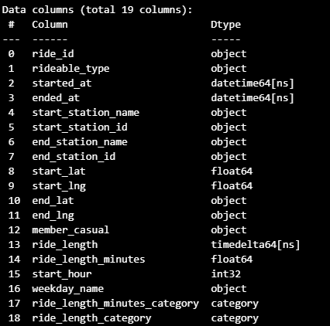
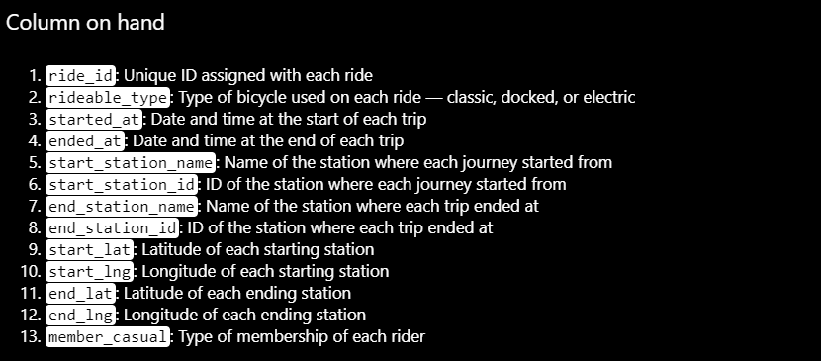
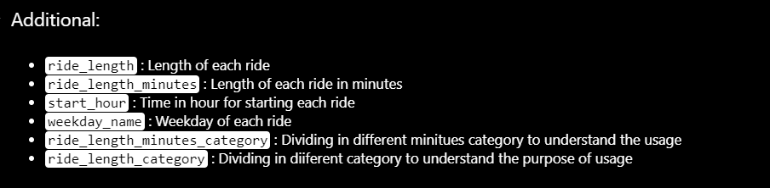

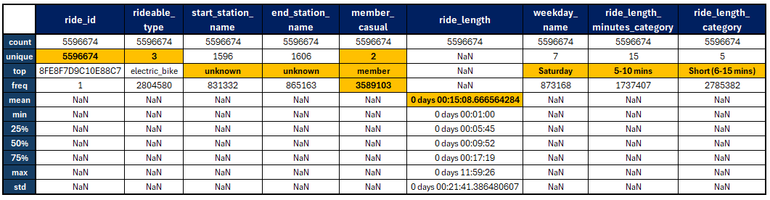
Prepare Phase
A. Description of Data
Info.
Explanation
Summary

Slide 22
Prepare Phase
A. Description of Data
Info.
Explanation
Summary

Slide 23
Prepare Phase
A. Description of Data
Info.
Explanation
Summary

Slide 24
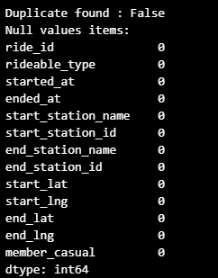
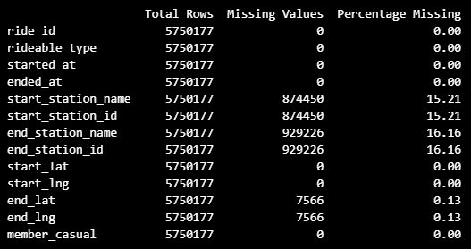
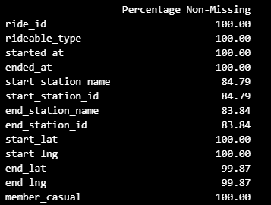
Prepare Phase
B. Data Cleaning
Cleaning and checking
Data Loss
Outlier

Slide 25
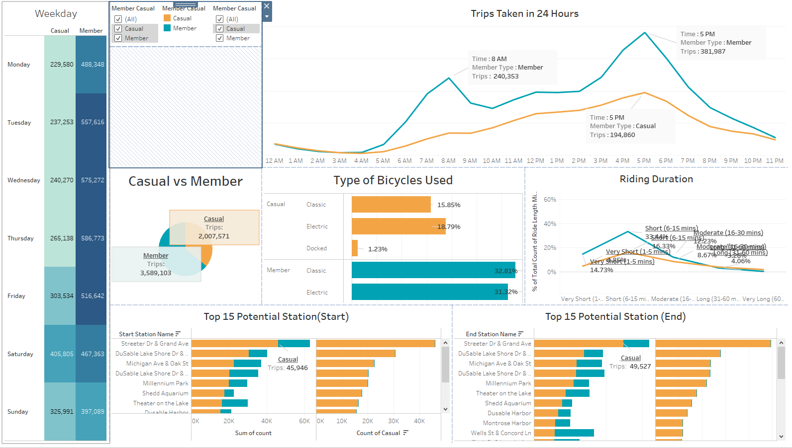
Analyze Phase
Tools:
Tableau

Slide 26
04
Analysis

Slide 27

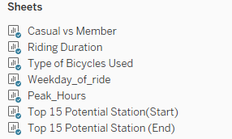
Analysis
Dashboard
Sheets

Slide 28
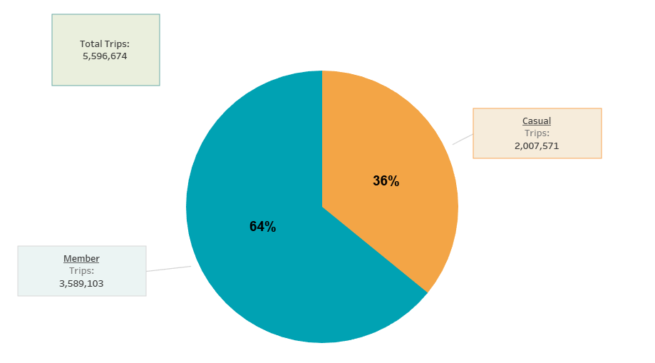
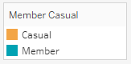
Analysis – Intro
Proportions
Highlight
Potential target : Casual Rider 36%

Slide 29
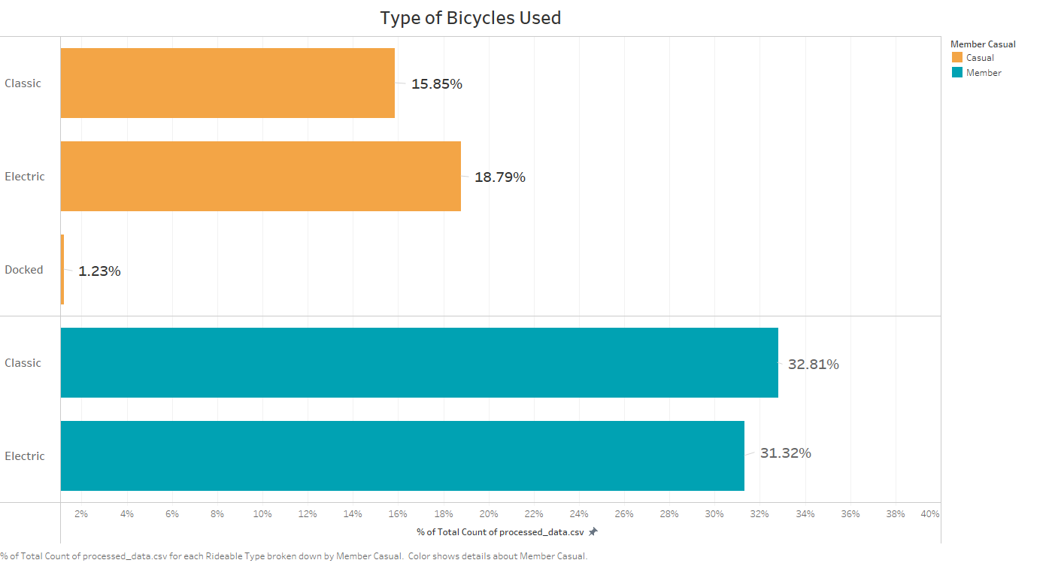
Analysis – Intro
Preference
Highlight
Classic : 44%
Electric : 52%
Docked : 4%
Slightly prefer Electric than Classic
Highlight
Classic : 51%
Electric : 49%
Evenly split in their preferences

Slide 30
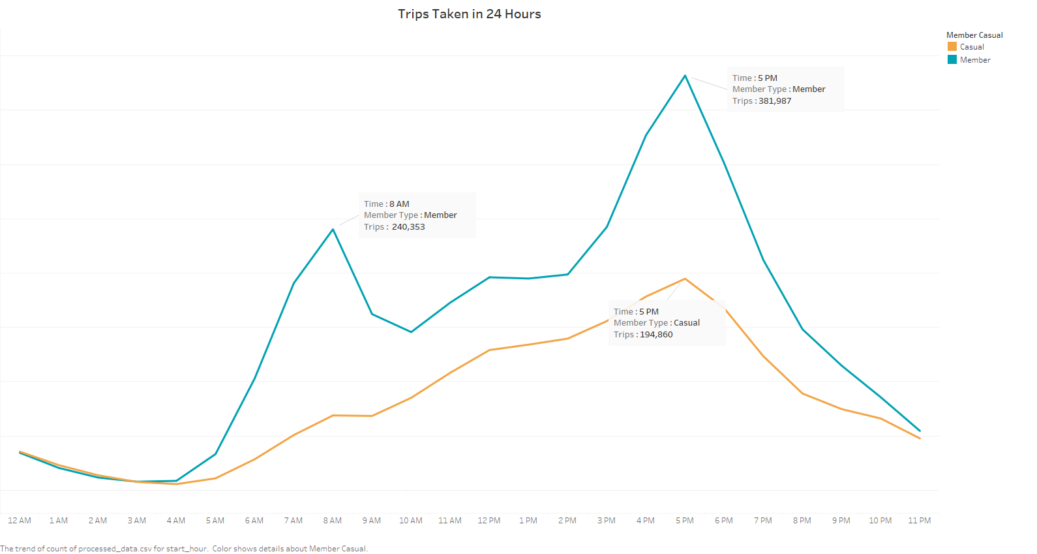
Analysis – Intro
Peak Usage
Highlight
Peak hours of member:
8 AM & 5 PM
Highlight
Peak hours of casual:
5 PM

Slide 31
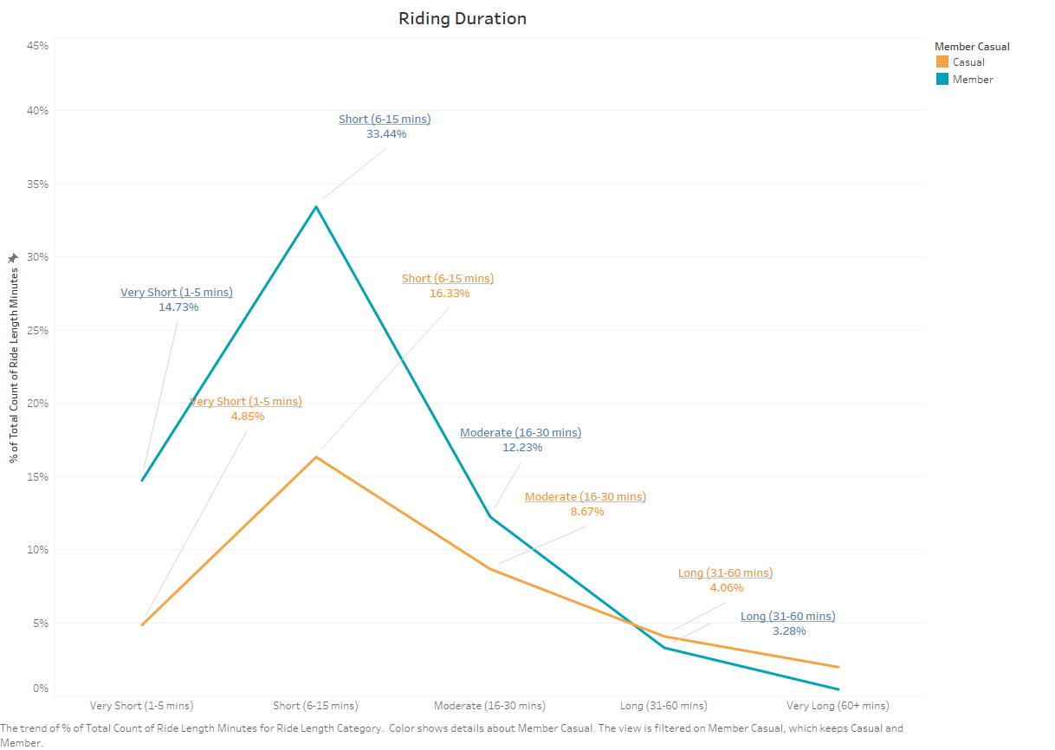
Analysis – Intro
Duration Preference
Highlight
Overall Trend:
Majority of rides fall within the 'Very Short' (1-5 minutes) and 'Short' (6-15 minutes) durations.
Highlight
Other Trend:
There's a noticeable but not significant use of bikes for 'Long’ (31-60 mins) and Very Long Rides (60+ mins) durations among casual riders, which is where they exceed member usage.

Slide 32
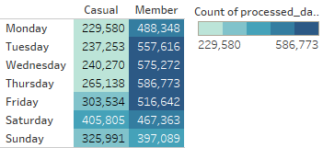
Analysis – Insight
Weekday Usage
Highlight
Member usage is highest on weekdays
Casual usage is highest on weekend

Slide 33
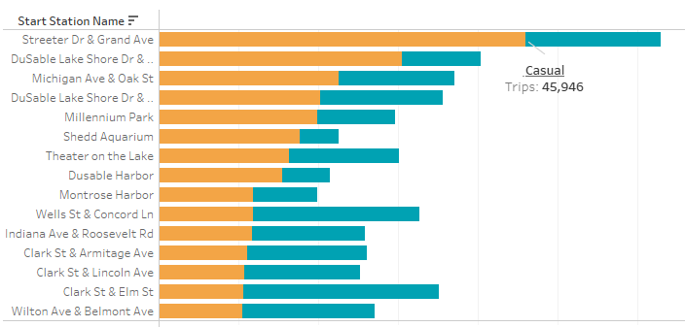
Analysis – Insight
High Usage Start Station
Highlight
Highest Usage start station’s member ratio is low
Most of the high usage start stations’ member ratio is low
It is potential to convert into member

Slide 34
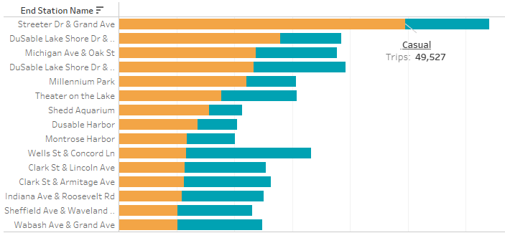
Analysis – Insight
High Usage End Station
Highlight
Highest Usage end station’s member ratio is low
Most of the high usage end stations’ member ratio is low
It is potential to convert into member

Slide 35
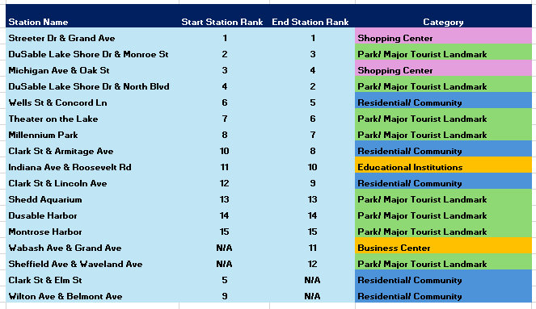
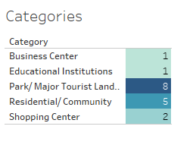
Analysis – Insight
Top 17 Stations

Slide 36
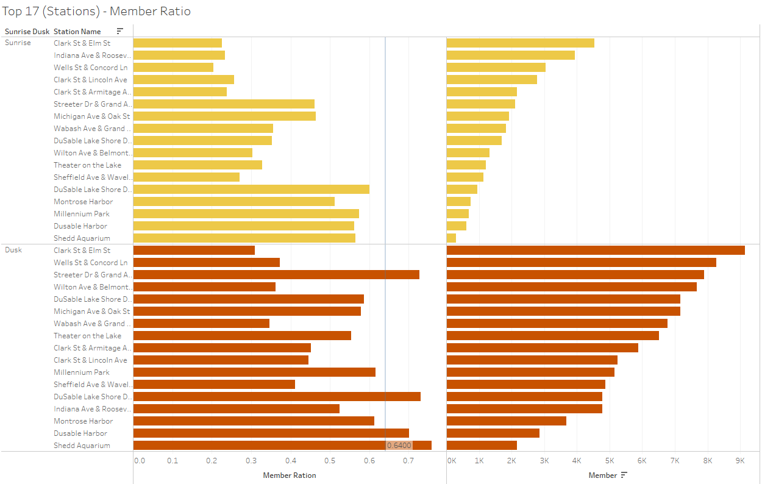
Analysis – Insight
Peak hours - Member Ratio (Stations)
Highlight
Member ratio is low during ‘Sunrise’ ( 7 - 9 AM ) period among all high usage start stations
Member ratio is relatively low to the average during ‘Dusk’ ( 3 - 7 PM ) period among most of the high usage start station.

Slide 37
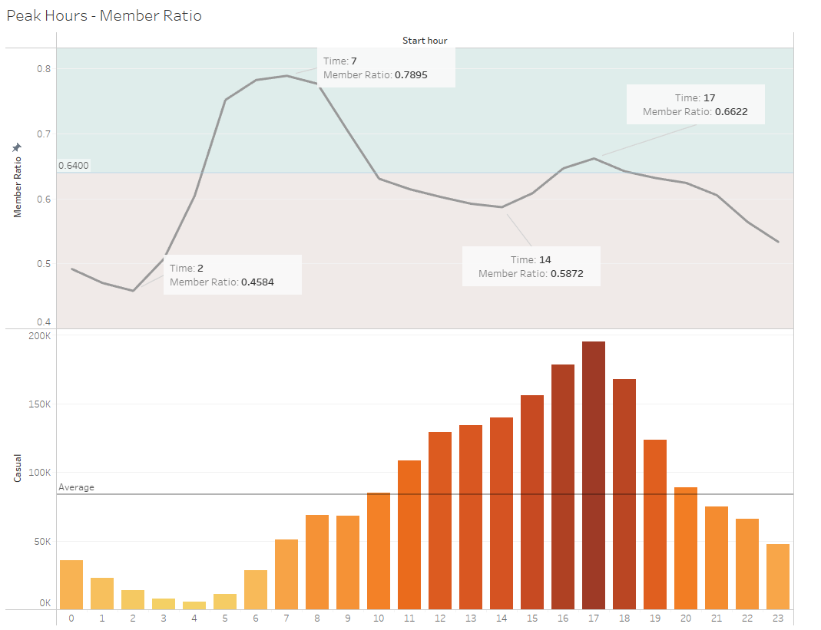
Analysis – Insight
Peak Hours – Member Ratio
Highlight
Although the member ratio is low among those top 17 high usage start stations in ‘Sunrise’ period, In overall, the member ratio in ‘Sunrise’ period is much higher than the average ratio.
Highlight
Number of casual user
Highlight
By considering the effectiveness,
we should focus on the ‘Dusk’ period to maximin the impact to convert casual user into member.

Slide 38


Insight Summary
GOAL
Member ratio in ‘Sunrise’ period is almost at a saturation status
Among the high usage start stations, most of them are potentials
Peak Hour Ratio
Potential Start Stations
Focusing on the second peak period at ‘Dusk’ period
Focusing on specific stations to utilize the promotion effort

Slide 39
05
Recommendation

Slide 40
“Strategies to maximize the number of annual memberships by converting casual riders”

Slide 41

Marketing Strategies Focus
Right Peak Hours
Right Stations
Right Weekday

Slide 42

Recommendation
Royalty Program
Collaborate with organizations and companies
Physical advertisements
Exclusive : Bikes, Reward program, Events promotion
Purpose : Increasing the incentive to accumulate their trip for rewards
Choice of Places : Collaborate with the companies and organizations nearby our high usage stations
Purpose : Increasing the exposure, ‘bike economy’
Offer discounted annual membership
Nature : In general, riding in the peak at weekend is prefer to be a group activities.
Purpose : Increase the incentive of a member to convince their friends, family.
Choice of Places : Let them know there is an option for them, especially for some places with hight member ratio
Purpose : Increase the exposure, Increase the understanding to us for customer

Slide 43
Follow up
“Missing” issue
User Feedback
User Data Collection
Purpose : Reducing the data loss
Example : Increasing the accuracy of the GPS function
Purpose : More data to understand the difference between member and causal users
Example : Surveys to reward a member discount
Pricing Data
Purpose : How pricing impacts customer retention and satisfaction
Example : Schedule of charges Price changing data
Purpose : Understanding our customers’ characteristics
Example : Royalty program

Slide 44

THANKS

